Slide 1




NEXT GEN EMPLOYABILITY PROGRAM
Creating a future-ready workforce
Team Members
College Name
Student Name :
Student ID :
Xyz

Slide 2

CAPSTONE PROJECT SHOWCASE
Project Title
voting application using django framework-ABDUL NAZER KANI(4001,SEC)
Abstract | Problem Statement | Project Overview | Proposed Solution | Technology Used | Modelling & Results | Conclusion

Slide 3
Abstract
In today's digital age, facilitating democratic processes efficiently and securely is paramount. This abstract presents a Django-based voting application designed to streamline the voting process while ensuring transparency, security, and accessibility.
The application leverages Django's robust framework to provide a user-friendly interface for voters to cast their ballots securely. It incorporates features such as user authentication, encrypted communication, and data integrity checks to safeguard the integrity of the voting process.
Source :

Slide 4
Problem Statement
The problem statement focuses on the following key issues:
Security Concerns: Existing voting systems are vulnerable to various security threats, including hacking, data manipulation, and identity fraud.
Transparency and Accountability: Lack of transparency in the voting process can undermine public confidence in election outcomes
Accessibility: Many voting systems fail to accommodate individuals with disabilities or those facing logistical barriers to participation.
User Experience: Complex or unintuitive interfaces can discourage voter turnout and lead to errors in the voting process.
Source :

Slide 5
Project Overview
User Authentication and Registration: Develop a secure authentication system for voters to register and log in to the platform, ensuring the validity of user identities.
Voting Interface: Design an intuitive and user-friendly interface for casting votes, accommodating various voting methods such as single-choice, multiple-choice, and ranked-choice voting.
Security Measures: Implement robust encryption protocols and security measures to protect the integrity and confidentiality of votes, preventing unauthorized access or tampering.
Transparency and Audit Trail: Incorporate features to maintain a transparent and accountable voting process, including an audit trail to track all interactions and ensure the verifiability of results.
Administrative Dashboard: Create a comprehensive administrative dashboard for election administrators to manage voter registration, monitor voting activity, and oversee result tabulation.
Scalability and Flexibility: Develop the application to be scalable and adaptable to various election scenarios, handling different voting scales and methods efficiently.
Result Tabulation: Automate the tabulation process to generate accurate and real-time election results, with options for exporting and analyzing voting data.
Source :

Slide 6
Proposed Solution
.
Planning and Design: Define project requirements, user stories, and system architecture. Develop wireframes and mockups to visualize the voting interface and administrative dashboard.
Development: Implement the core features of the voting application using the Django framework. Focus on security, usability, and scalability throughout the development process.
Testing and Quality Assurance: Conduct thorough testing to identify and fix bugs, vulnerabilities, and usability issues. Perform security audits to ensure the application's integrity and resilience to attacks.
Deployment and Launch: Deploy the application to a secure server environment. Conduct user acceptance testing (UAT) and address any final issues before the official launch.
Maintenance and Support: Provide ongoing maintenance, updates, and support to address user feedback, security threats, and system enhancements.
Source :

Slide 7
pip install Django
django-admin startproject voting_app
# models.py
from django.db import models
from django.contrib.auth.models import User
class UserProfile(models.Model):
user = models.OneToOneField(User, on_delete=models.CASCADE)
# Add additional fields as needed (e.g., user type, voter ID, etc.)
class Vote(models.Model):
user = models.ForeignKey(User, on_delete=models.CASCADE)
# Add fields for vote data (e.g., candidate choices, timestamp, etc.)
# urls.py
from django.contrib.auth import views as auth_views
Source :

Slide 8
urlpatterns = [
# Other URLs
path('accounts/', include('django.contrib.auth.urls')),
]
<!-- vote.html -->
<form method="post">
{% csrf_token %}
<!-- Add form fields for voting options -->
<button type="submit">Submit Vote</button>
</form>
Source :

Slide 9


Technology Used
Front-end
Back-end
Source :

Slide 10
Modelling & Results
In the Django voting application, we need to define models to represent users, their votes, and any additional data required for the application.
# models.py
from django.db import models
from django.contrib.auth.models import User
class UserProfile(models.Model):
user = models.OneToOneField(User, on_delete=models.CASCADE)
# Additional fields for user profile if needed
class Candidate(models.Model):
name = models.CharField(max_length=100)
# Add more fields as needed (e.g., party affiliation, etc.)
class Vote(models.Model):
user = models.ForeignKey(User, on_delete=models.CASCADE)
candidate = models.ForeignKey(Candidate, on_delete=models.CASCADE)
timestamp = models.DateTimeField(auto_now_add=True)
Source :

Slide 11
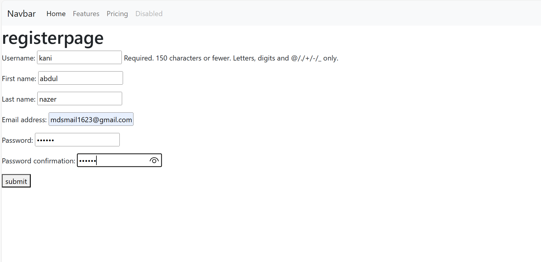
Register page

Slide 12
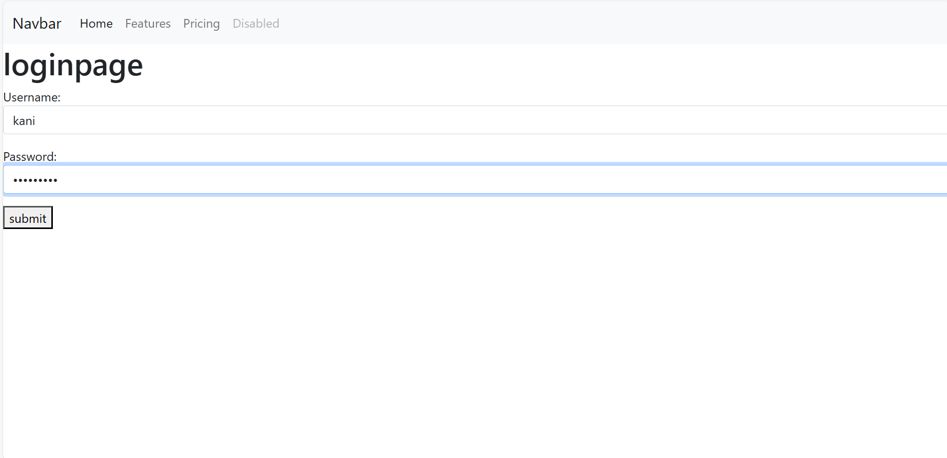
Login page

Slide 13
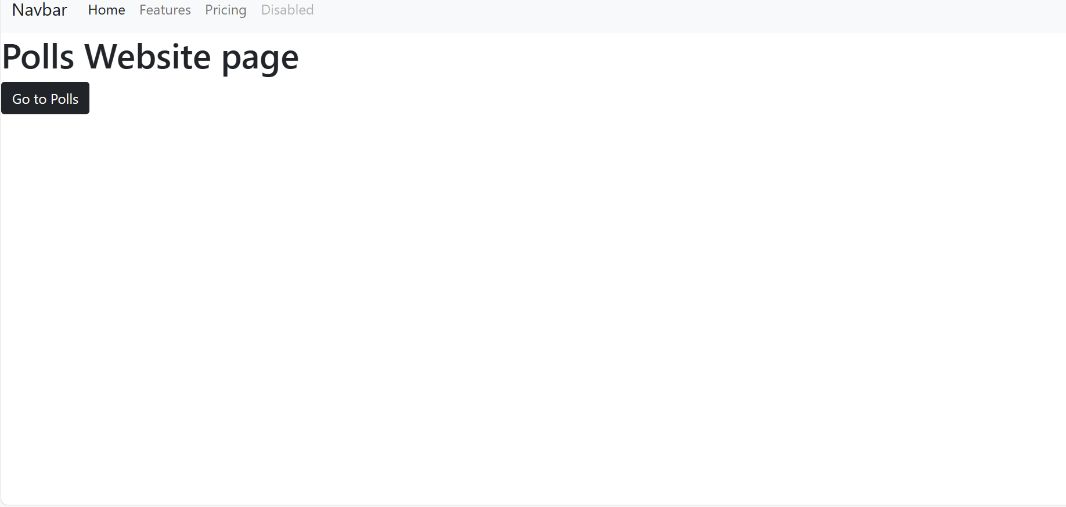
Homepage

Slide 14
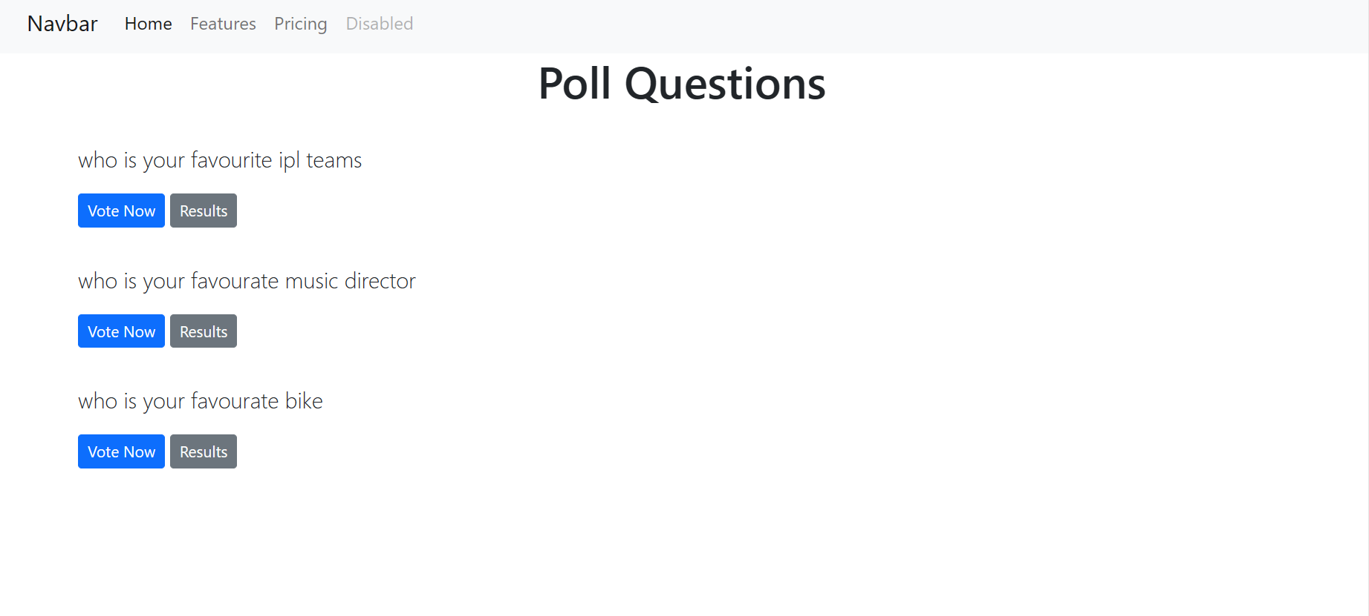
Poll Question

Slide 15
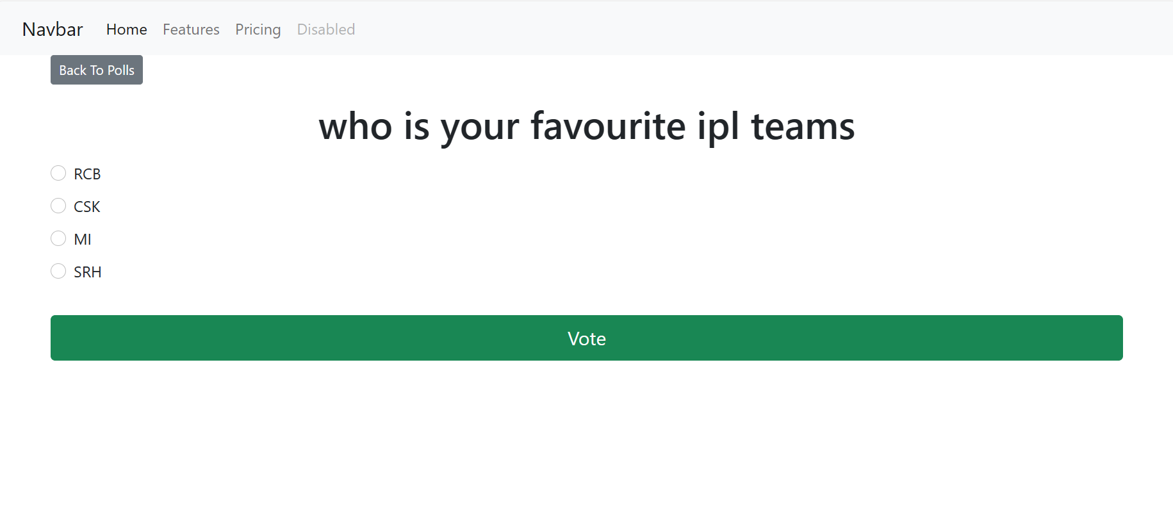
Service-Page

Slide 16
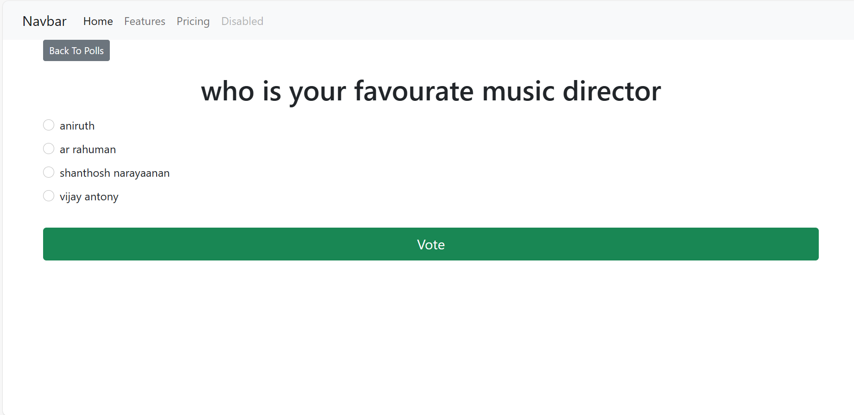

Slide 17
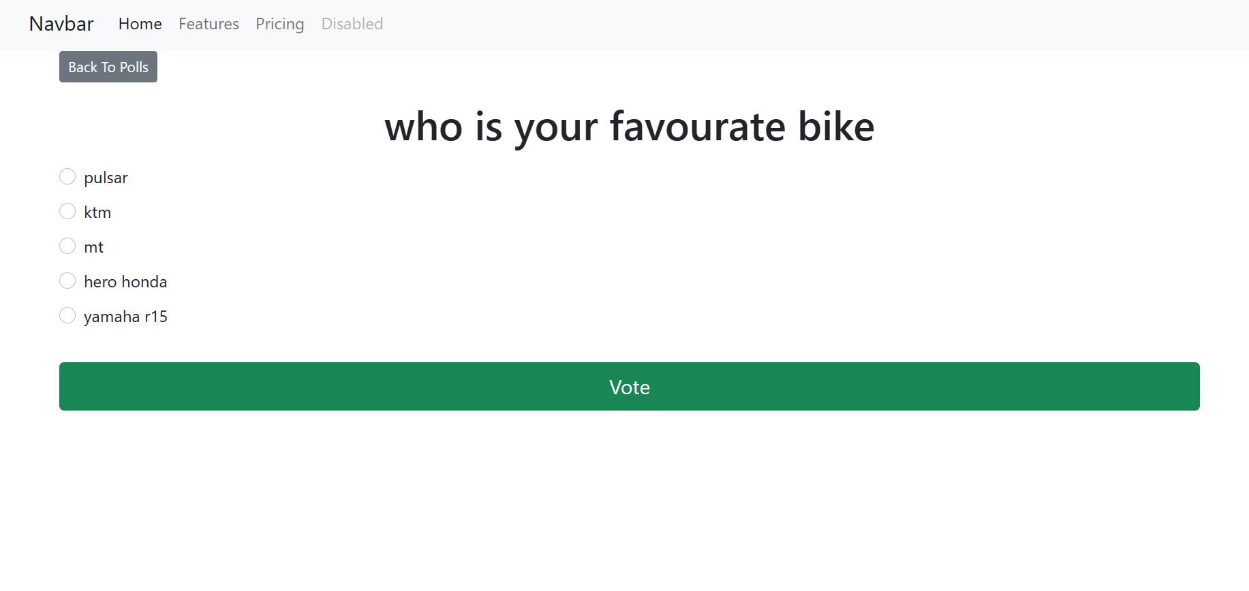

Slide 18
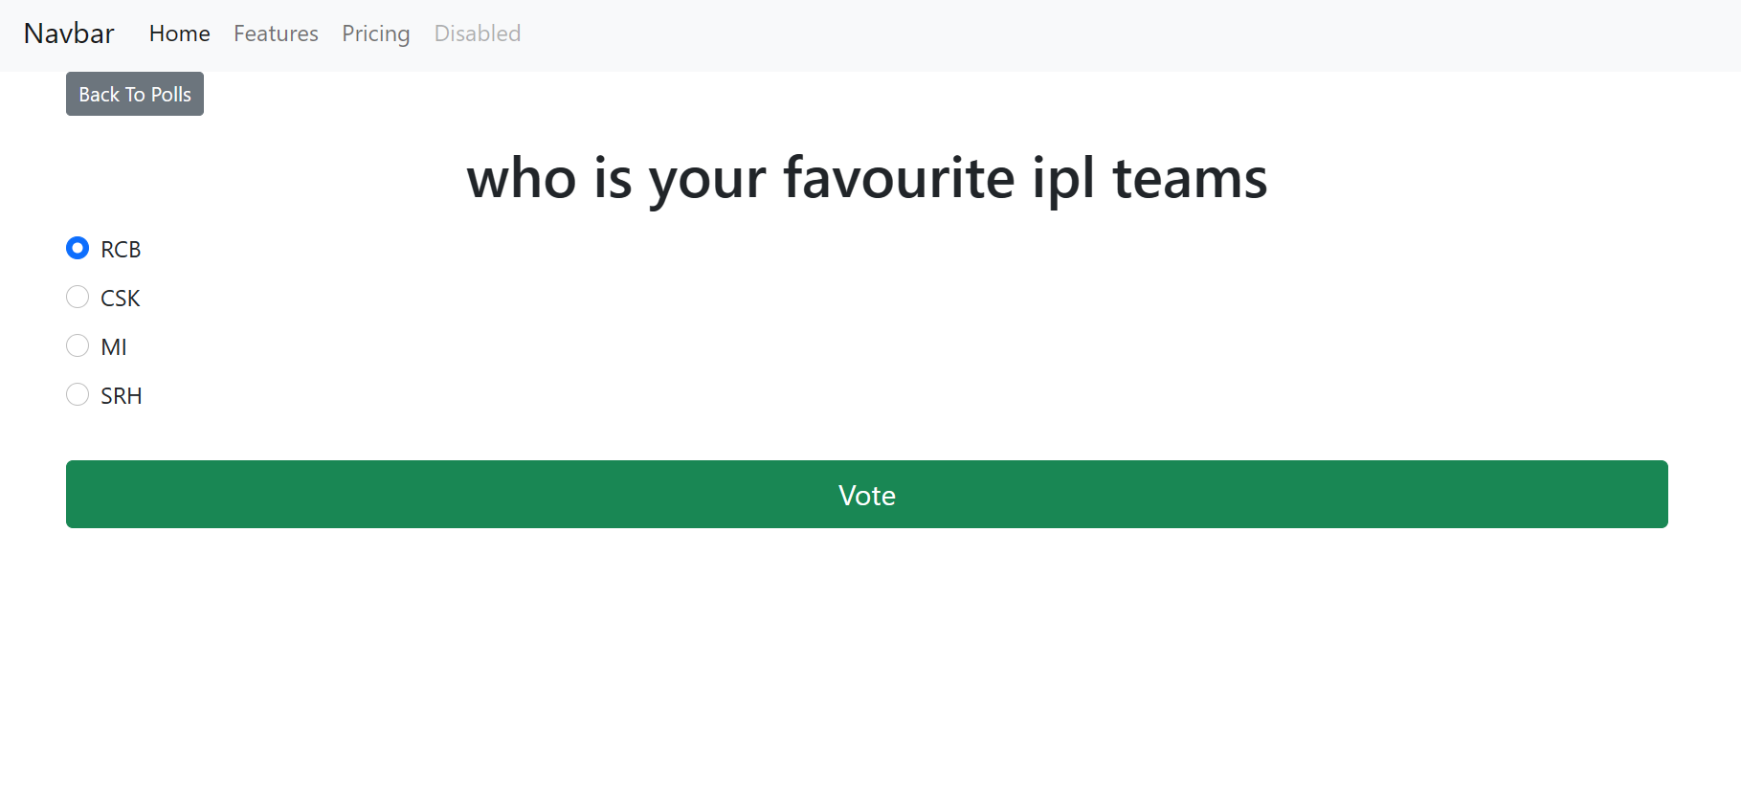
Voting page

Slide 19
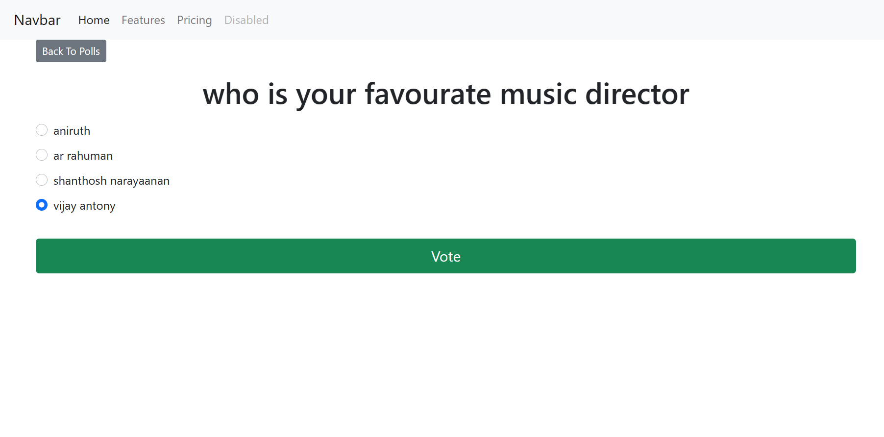

Slide 20
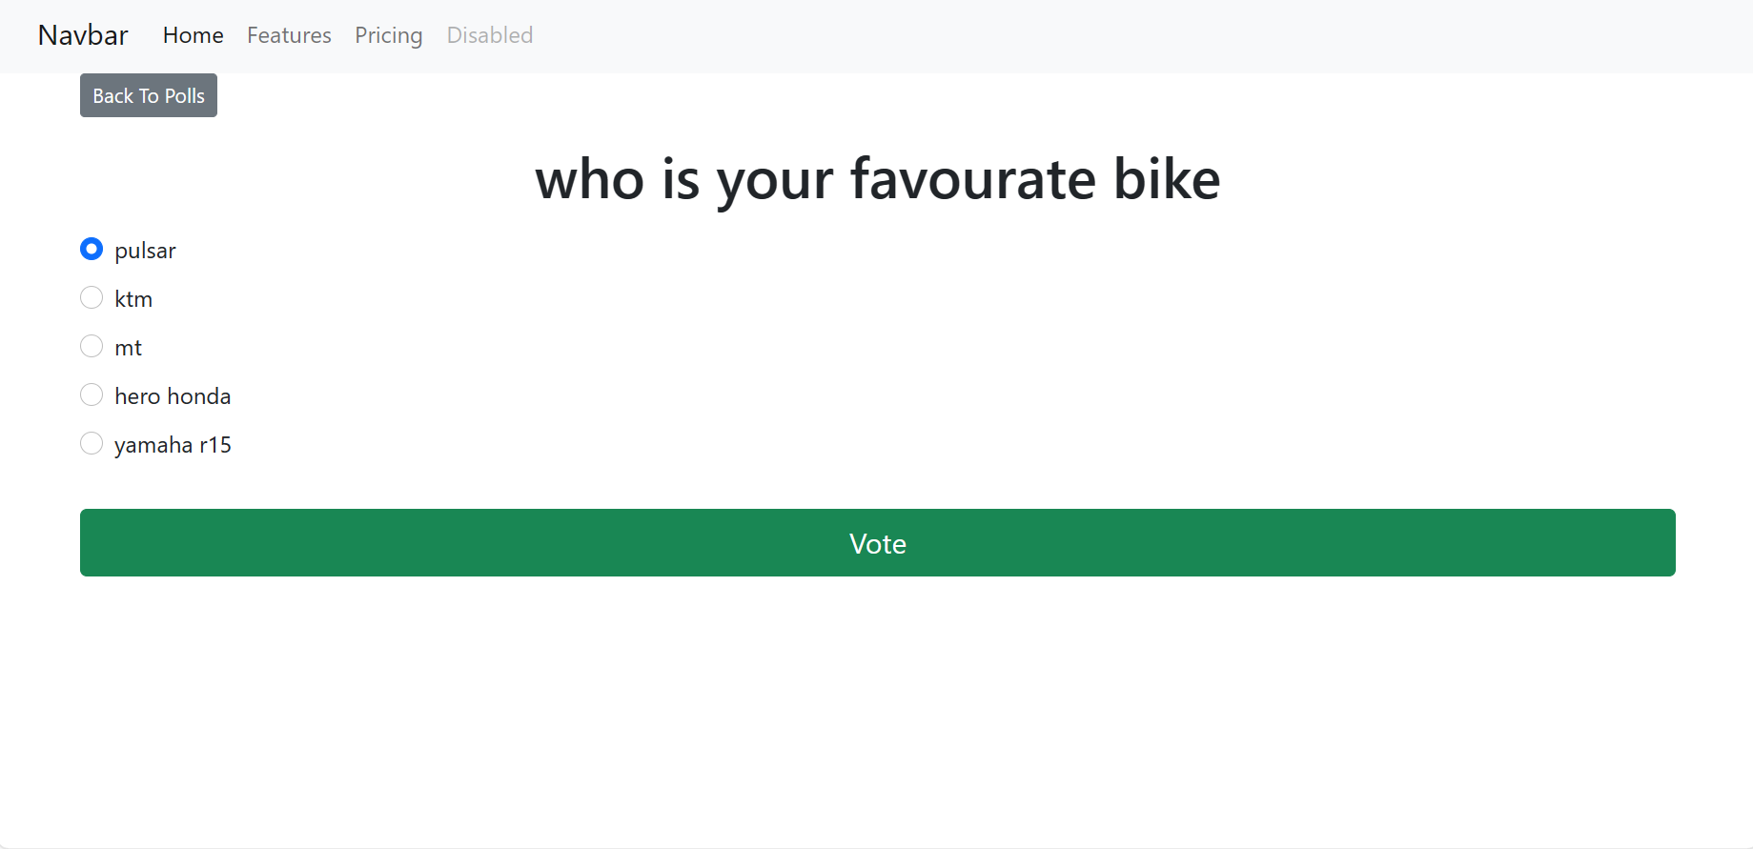

Slide 21
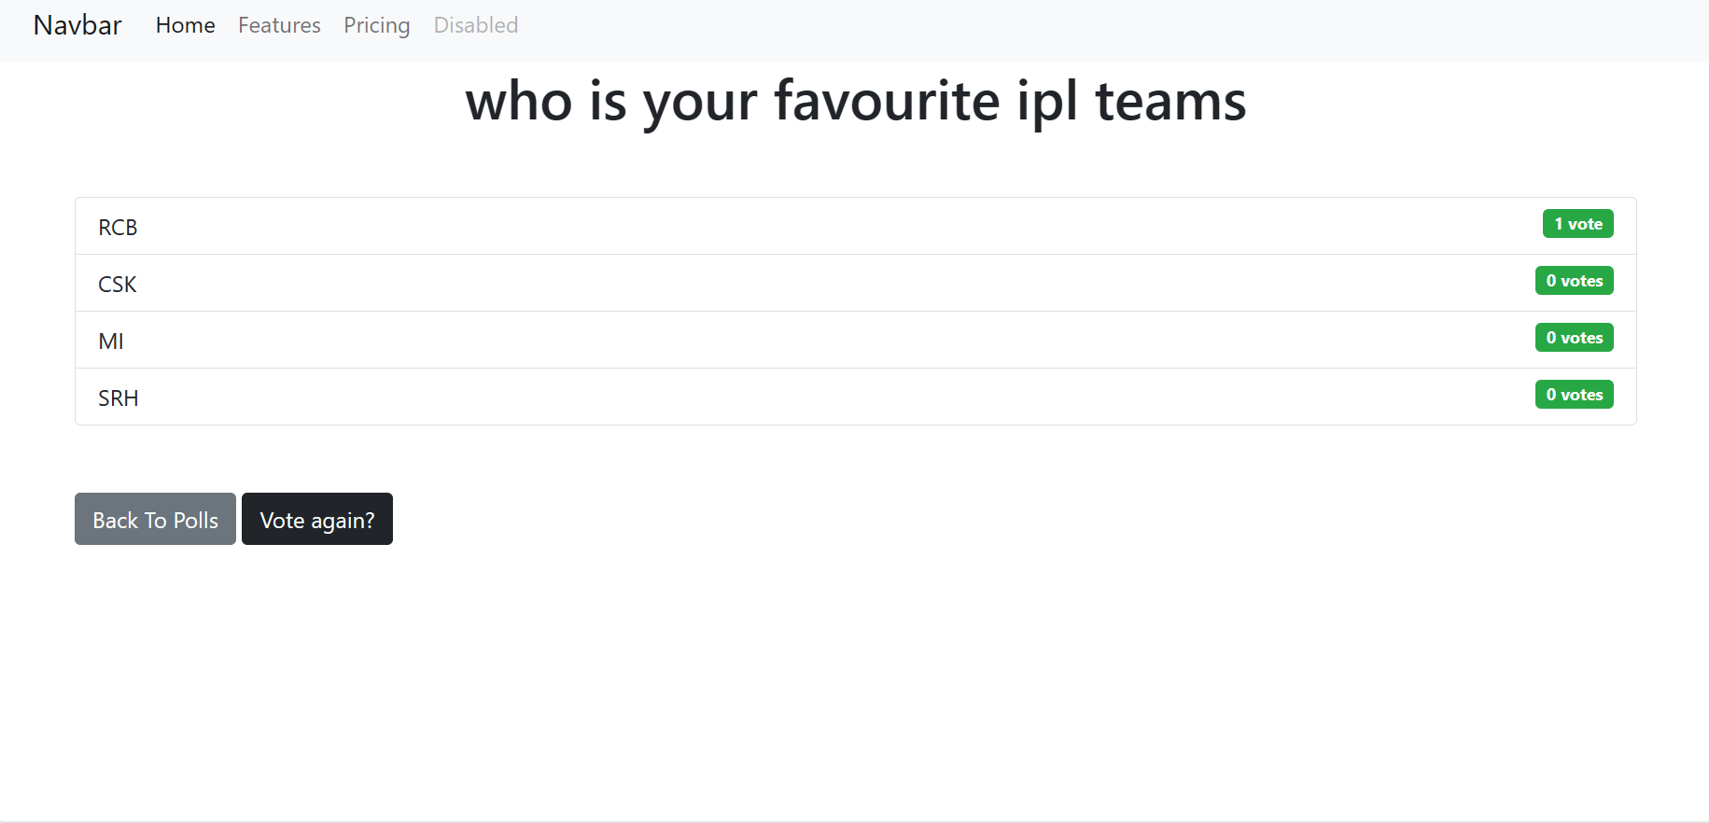
Result

Slide 22
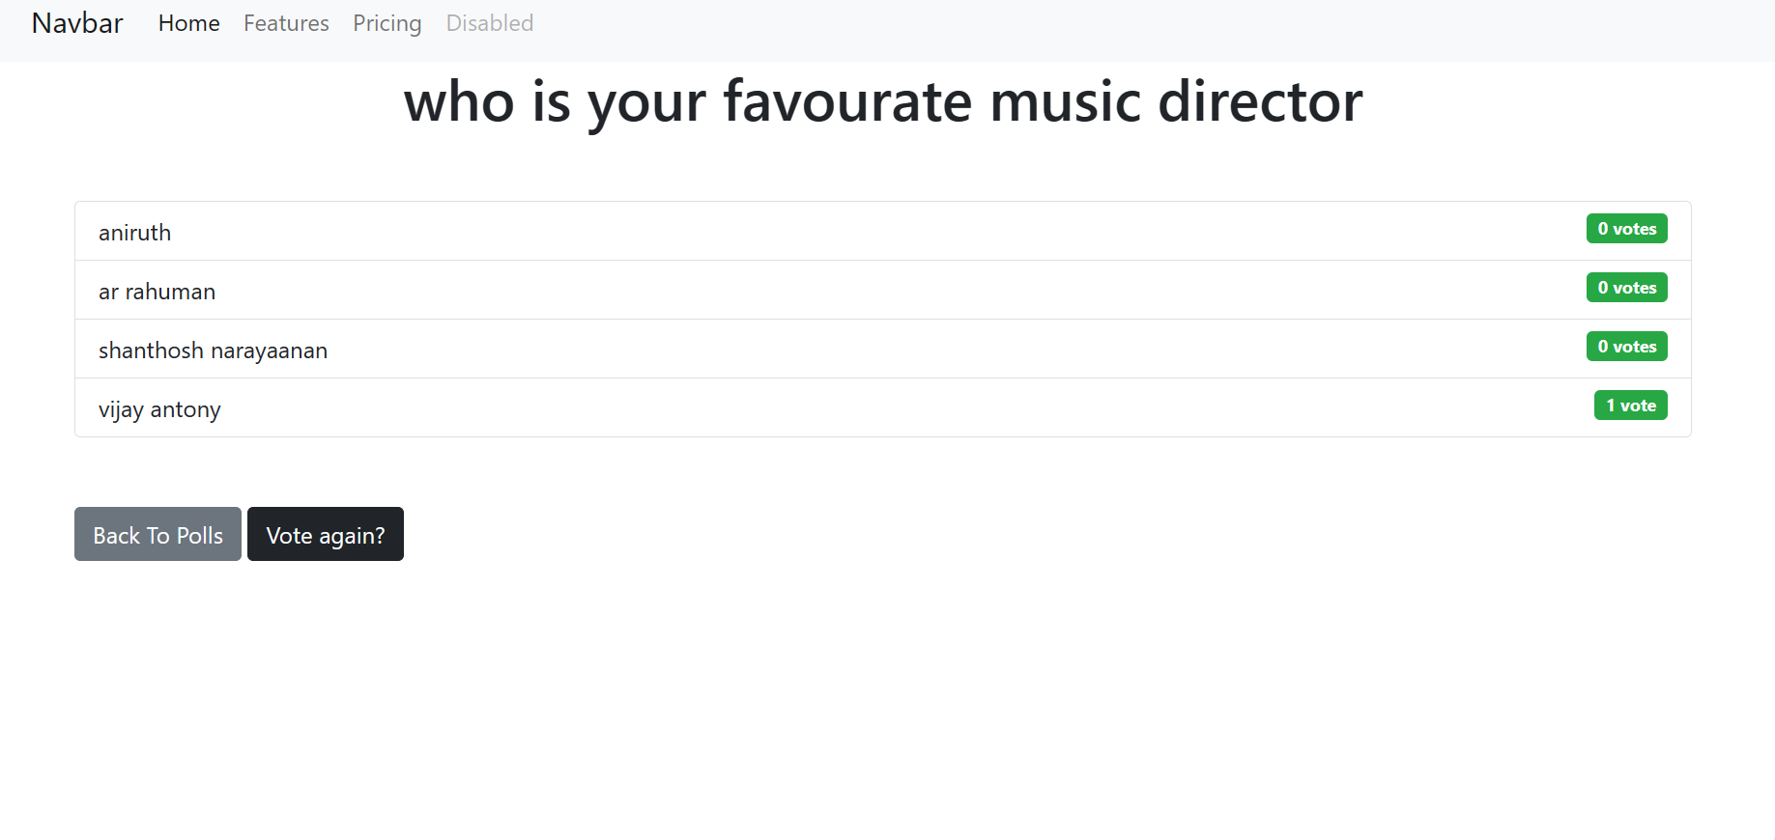

Slide 24
Future Enhancements:
The future holds exciting possibilities for advancements across various fields. Here are some potential areas where enhancements could make a significant impact:
Artificial Intelligence and Machine Learning
Biotechnology and Healthcare
Renewable Energy
Space Exploration
Quantum Computing
Augmented and Virtual Reality
Blockchain and Cryptocurrency
Advanced Materials
Autonomous Vehicles
Environmental Remediation

Slide 25
Conclusion
In conclusion, the future holds immense potential for advancements across a wide range of fields, driven by ongoing innovation, collaboration, and the relentless pursuit of knowledge. From artificial intelligence and biotechnology to renewable energy and space exploration, each area presents opportunities to address pressing global challenges and improve the quality of life for people around the world.
Source :

Slide 26
Thank You!
Notes:
Thank You !!

